Slide 1
Non-Relational Database Language: Query Universal Interface (QUI)
Haak Saxberg & Jess Hester

Slide 2
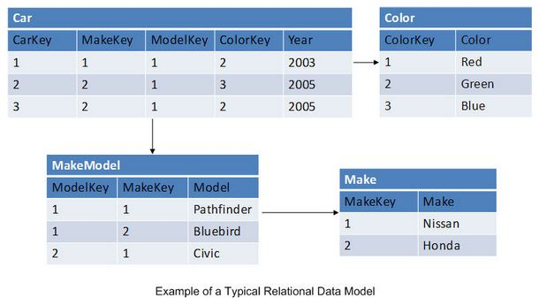
Relational Databases
What you’re probably familiar with
SQL (MySQL, PostgreSQL, etc)
Group of tables made up of columns and rows

Slide 3
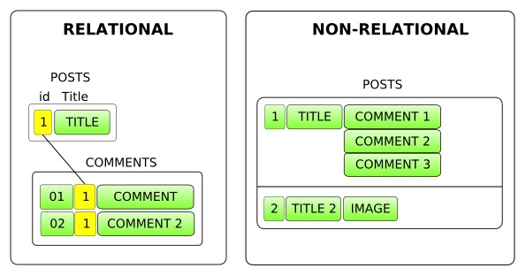
Non-Relational Databases
Also hierarchical database
Vary between implementations
Schema-less
Generally, one parent per child, but parents can have many children (1:N mapping)
Unique primary key for each entry
Can be more flexible/scalable than relational databases

Slide 4
Problems
Relational databases have many management systems (namely, SQL)
Non-relational databases growing in popularity, no common language
Difficult to manage multiple backends or switch backends
MongoDB and Google AppEngine have very different APIs and access commands
Solution: DSL for accessing nonrelational databases!
Domain expert can use multiple databases without learning usage of entirely new API

Slide 5
The Language: QUI
Can ‘put’ an entry in the database
Can ‘get’ an entry from the database using a primary key
Written in Python -- availability of APIs, familiarity of language writers. Heavy usage of decorators and other metaprogramming inherent in Python
Converts between native Python types and database-aware types (e.g. Integer to IntegerField)

Slide 6
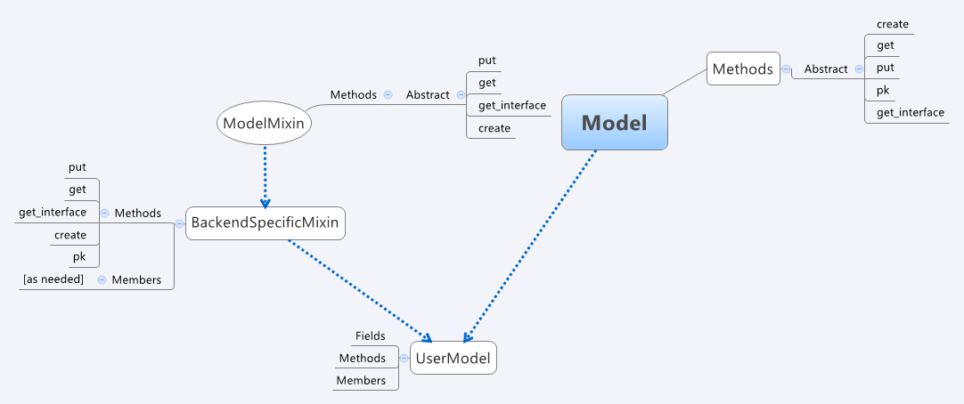
Magic: Fields, Models, & Mixins

Slide 7
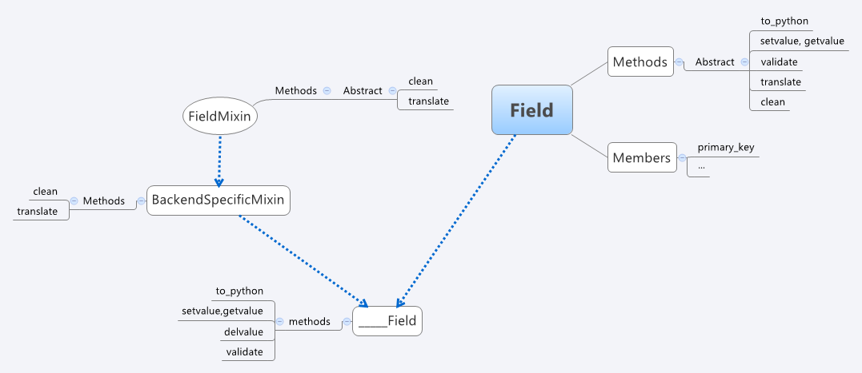
Magic: Fields, Models, & Mixins

Slide 8
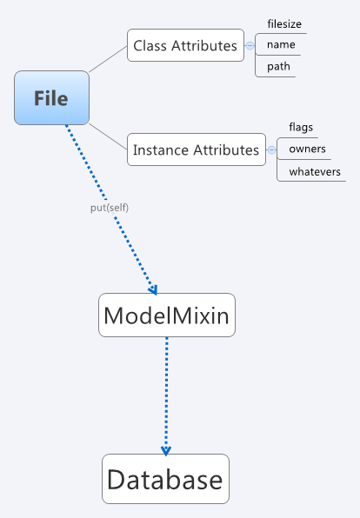
Computational Model: Put
f = File()
f.pretty_print() filesize:1024 name:jigglybits.jpg path:/.funsies/ flags:uws ...
f.put() <result of putting>

Slide 9
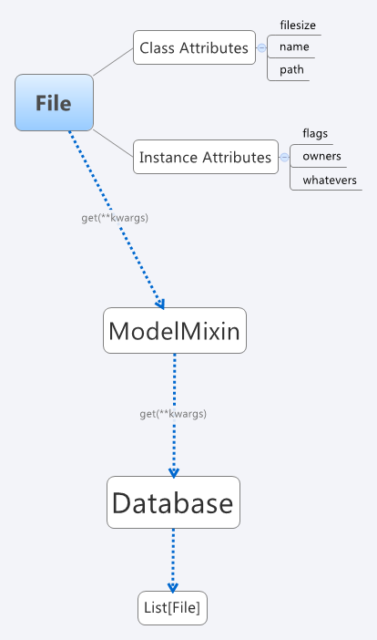
Computational Model: Get
fs = File.get( name=“jigglybits.jpg” )
fs
[“jigglybits.jpg”,...]
f = fs[0]
f.pretty_print() filesize:1024 name:jigglybits.jpg path:/.funsies/ flags:uws ...
hasattr(f, “get”) False

Slide 10
User Input
Code!
Only MongoDB right now…

Slide 11
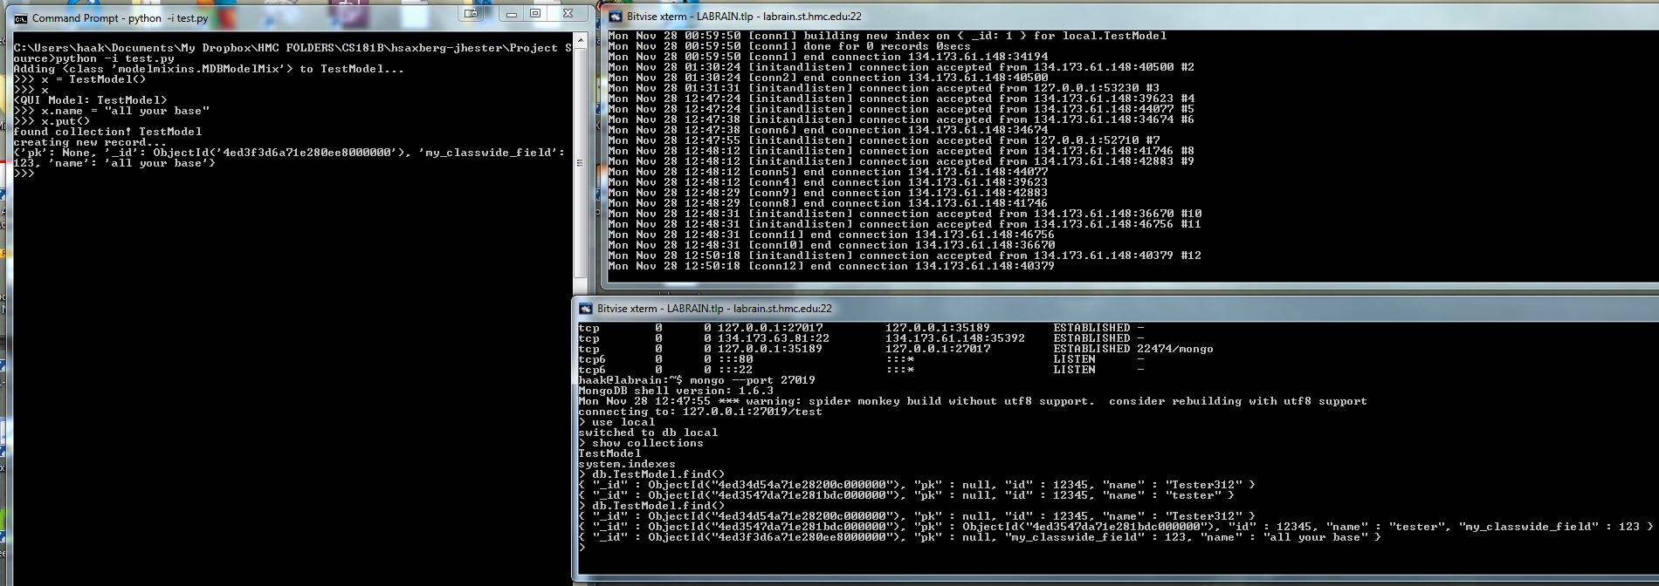
putting
A model with on-the-fly fields

Slide 12
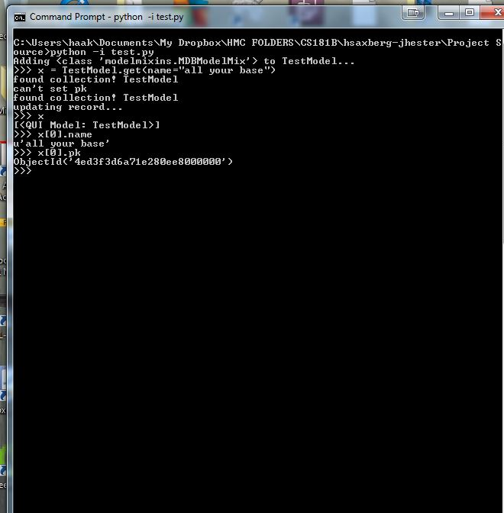
Getting
A model instance (or instances) from the database

Slide 13
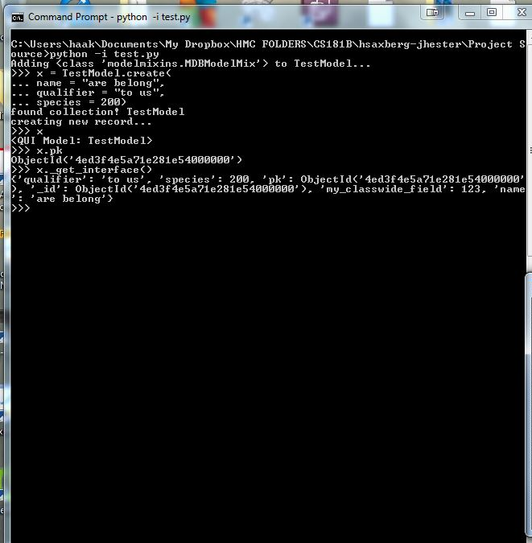
Creating
A model with arbitrary initial fields and values

Slide 14
Sources
http://www.readwriteweb.com/enterprise/2009/02/is-the-relational-database-doomed.php
http://bytesforlunch.wordpress.com/page/21/

